Slide 1
Leveraging Data Center Federation in Seismology
EAR-1724509 - SAGE
Dr. Tim Ahern
Incorporated research institutions for Seismology (IRIS) &
International Federation of Digital Seismograph Networks (FDSN)
This material is based upon work supported by SAGE which is a major facility fully funded by the National Science Foundation.

Slide 2
The beginning of metadata and time series harmonization in seismology
In about 1987 the FDSN began the development of the Standard for Exchange of Earthquake Data (SEED) format
Specifies the form of metadata used in exchanging time series data
Specifies the exact binary format of the time series data
Later developments
More recently (2010-2012) the metadata moved into the StationXML format
2013 FDSN approved web service standards for dataselect, station, and event
Based upon existing IRIS versions
Timeseries moving from miniSeed to xSeed from 2016 to present
Deployment of standardized web services at multiple data centers

Slide 3
Standardized services
fdsnws-station
metadata describing observatory points that measure a variety of time series data
fdsn-ws-event
Earthquake catalogs
fdsnws-dataselect
Time series data
fdsnws-availability
Detailed inventory of timeseries holdings

Slide 4
Fedcatalog an IRIS Federated model in seismology
DC1
DC2
DC3
DC4
DC 5
DC 6
DC 7
Client
IRIS
fedcatalog Service
DC n

Slide 5
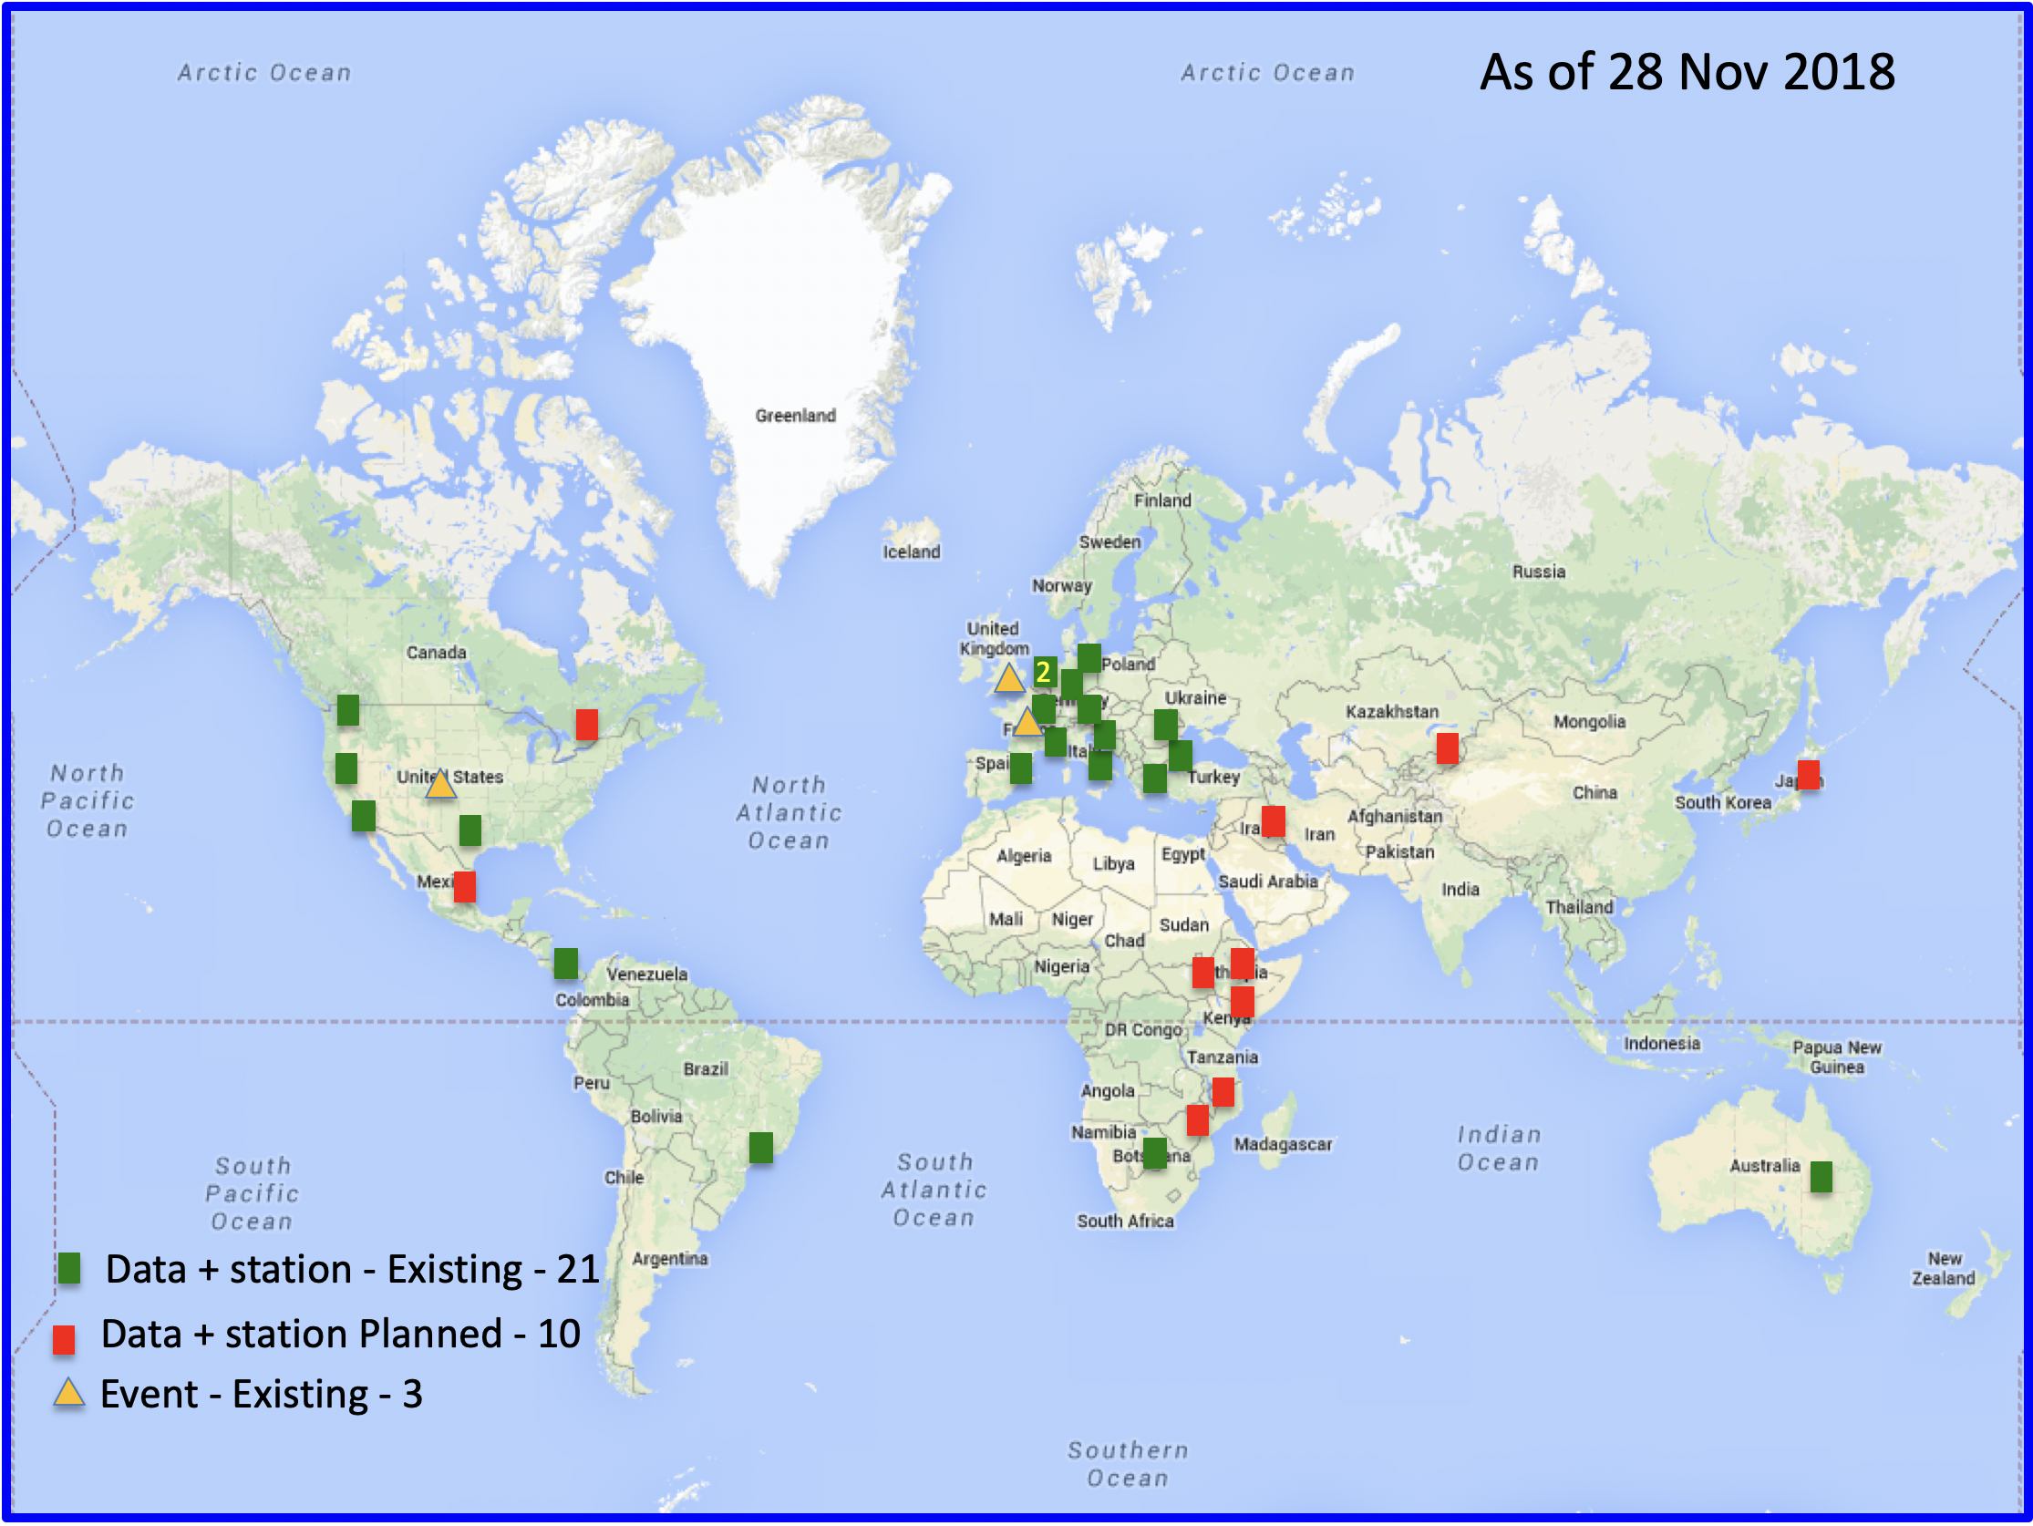
International Federation of Data Centers
24 Active Nodes
on
5 continents

Slide 6
Federated Discovery
232 stations from 5 different data centers
2 GEOFON – Germany
2 INGV – Italy
143 IRIS- USA
37 Kandilli – Turkey
19 ORFEUS – Europe
41 RESIF - France

Slide 7
Federated clients
Web applications
GMAP
WILBER3
MDA
Clients
Fetchdata
ObsPy
MATLAB (irisfetch)

Slide 8
Repositories at the IRIS DMC: How IRIS leverages federation concepts internally
Breqfast
Request
Realtime
Web services
Federated Fetchdata
IRIS SEED &
IRIS PH5
IRIS DMC
IRIS ADC
Seed
Repository
Seed
Repository
Global Load Balancer
PH5
Repository
PH5
Repository

Slide 9
What IRIS Federated Repositories Means for You
You can make either BREQ_FAST or web service requests and seamlessly get data back from any of the PH5 and SEED repositories.
ADC and DMC provide redundancy and reliability
Global load balancing improves performance

